Slide 1
STM32F401RE
Visteon Academy

Slide 2
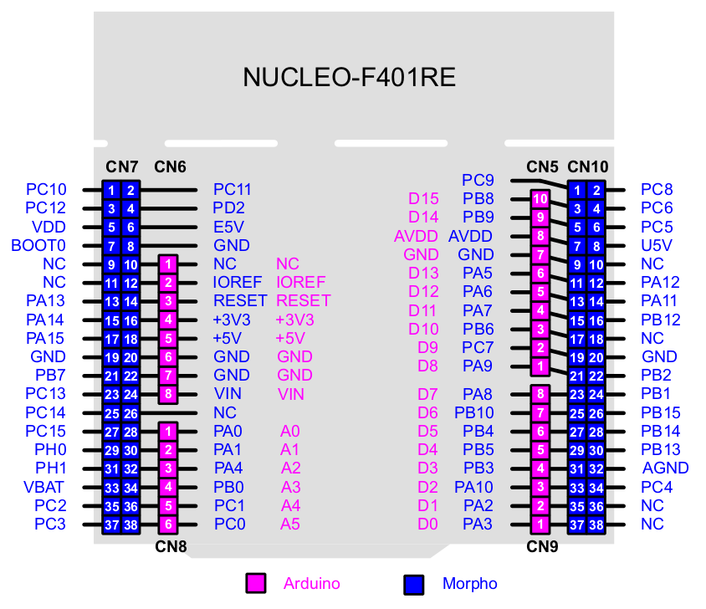
Understanding the STM32 GPIO
What is GPIO ?
General-Purpose Input/Output – generic pin on an integrated circuit.
Can be configured as input or output
Controllable by the user at run time

Slide 3
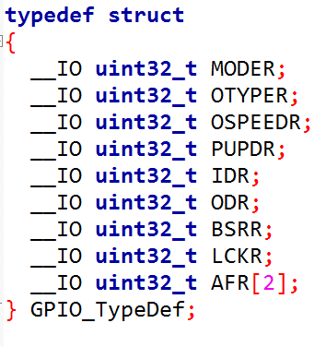
GPIO Registers
5 general purpose input/output (GPIO) ports named Port A, B, C, D and F
Each port has up to 16 pin
Each port can be configured by the user
Each port has associated with it the following registers:
GPIO port mode register (GPIOx_MODER)
GPIO port output type register (GPIOx_OTYPER)
GPIO port output speed register (GPIOx_OSPEEDR)
GPIO port pull-up/pull-down register (GPIOx_PUPDR)
GPIO port input data register (GPIOx _IDR)
GPIO port outp ut data register (GPIOx_ODR)
GPIO port bit set/reset register (GPIOx _BSRR)
GPIO port configuration lock register (GPIOx_LCKR)
GPIO alternate function low register (GPI Ox_AFRL)
GPIO alternate function high register (GPIOx_AFRH)
GPIO Port bit reset register (GPIOx_BRR)

Slide 4
GPIO Registers
GPIO port mode register (GPIOx_MODER)
00 use pin as digital input
01 use pin as output
11 use pin as analog input
10 use pin as external peripheral source (SPI, UART, I2C…etc)
GPIO port output type register (GPIOx_OTYPER)
Output push-pull
Output open-drain
GPIO port output speed register (GPIOx_OSPEEDR)
Low speed 2MHz
Medium speed 10MHz
High speed 50Mhz

Slide 5
GPIO Registers
GPIO port pull-up/pull-down register (GPIOx_PUPDR)
No pull-up, pull-down
Pull up
Pull-down
GPIO port input data register (GPIOx _IDR)
Read only
Read 0 - 0V (GND)
Read 1 - 3,3V (Vdd)
GPIO port output data register (GPIOx_ODR) - Good if you want to write to the entire port.
Write 0 - 0V (GND)
Read 1 - 3,3V (Vdd)

Slide 6
GPIO Registers
GPIO port bit set/reset register (GPIOx _BSRR)
Allows you to set/clear particular pin
GPIO port configuration lock register (GPIOx_LCKR)
bit [15:0] are used to lock the configuration of the GPIO. Each lock bit freezes a specific configuration register.
GPIO alternate function low register (GPI Ox_AFRL)
These bits are written by software to configure alternate function I/Os
GPIO alternate function high register (GPIOx_AFRH)
These bits are written by software to configure alternate function I/Os
GPIO Port bit reset register (GPIOx_BRR)
Allows alotic read/modify accesses to any of the GPIOx_ODR registers.

Slide 7

www.visteon.com

